Slide 1
PHOTO ELECTRIC EFECT
emitting electron from metal surface light falls on it

Slide 2
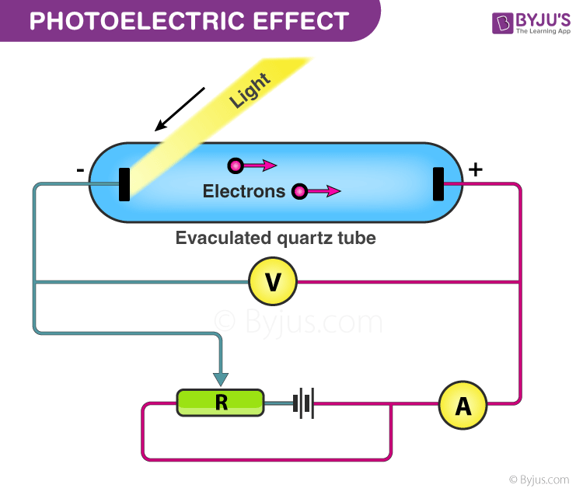
Factors Effecting Photo Electric effect
With the help of this apparatus, we will now study the dependence of the photoelectric effect on the following factors.
The intensity of incident radiation.
A potential difference between metal plate and collector.
Frequency of incident radiation

Slide 3
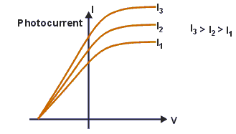
Effects of Intensity of Incident Radiation on Photoelectric Effect
The potential difference between the metal plate, collector and frequency of incident light is kept constant and the intensity of light is varied:
The electrode C i.e. collecting electrode is made positive with respect to D (metal plate). For a fixed value of frequency and the potential between the metal plate and collector, the photoelectric current is noted in accordance with the intensity of incident radiation.
It shows that photoelectric current and intensity of incident radiation both are proportional to each other. The photoelectric current gives an account of the number of photoelectrons ejected per sec.
.

Slide 4
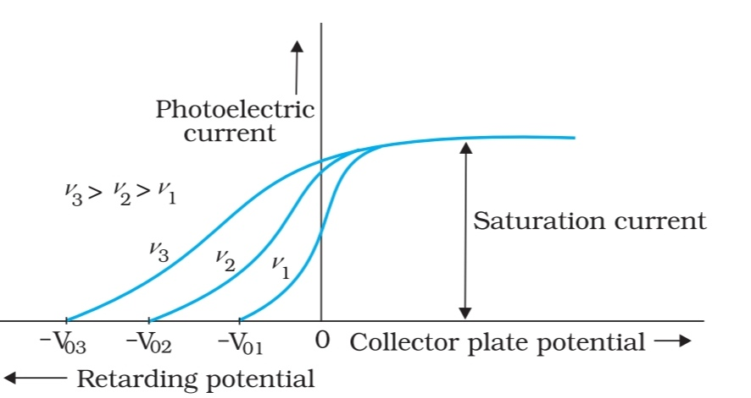
Effect of Frequency on Photoelectric Effect
The intensity of light is kept constant and the frequency of light is varied:
For a fixed intensity of incident light, variation in the frequency of incident light produces a linear variation of the cut off potential/stopping potential of the metal. It is shown that the cut off potential (Vc) is linearly proportional to the frequency of incident light
The kinetic energy of the photoelectrons increases directly proportionally to the frequency of incident light to completely stop the photoelectrons. We should reverse and increase the potential between the metal plate and collector in (negative value) so the emitted photoelectron can’t reach the collector.
.

Slide 5
Applications of Photoelectric Effect
Used to generate electricity in Solar Panels. These panels contain metal combinations that allow electricity generation from a wide range of wavelengths.
Motion and Position Sensors: In this case, a photoelectric material is placed in front of a UV or IR LED. When an object is placed in between the Light emitting diode(LED) and sensor, light is cut off and the electronic circuit registers a change in potential difference
Lighting sensors such as the ones used in smart phones enable automatic adjustment of screen brightness according to the lighting. This is because the amount of current generated via the photoelectric effect is dependent on the intensity of light hitting the sensor.
Digital cameras can detect and record light because they have photoelectric sensors that respond to different colors of light.
X-Ray Photoelectron Spectroscopy (XPS)

